Slide 1

DiscoGAN: Discover Cross-Domain Relations GANs
Presented by Trong-Binh Nguyen-202388548 Pusan National University
December 5th, 2023

Slide 2
Table of contents
Introduction
DiscoGAN Introduction
GANs Revision
Introduction
Components
Minimax problem
DiscoGAN
Idea
Performance

Slide 3
1. Introduction
Paper title: "Learning to Discover Cross-Domain Relations with Generative Adversarial Networks" Kim Taeksoo,
et al. International conference on machine learning. PMLR, 2017.
This work proposed method based on GANs that learn to discover relations between different domains
Using the discovered relations, this work successfully transfers style from one domain to another while preserving key attributes such as orientation and face identity.

Slide 4
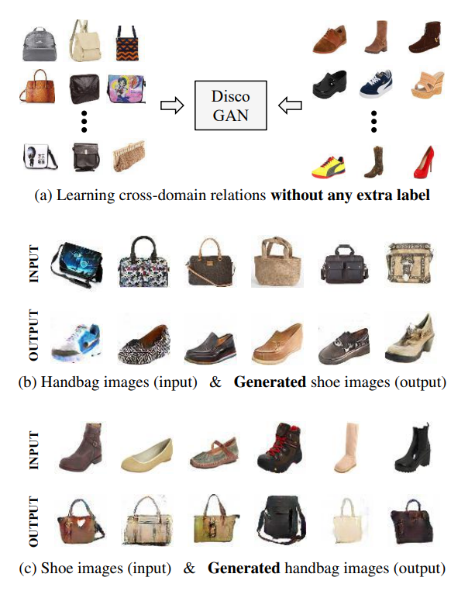
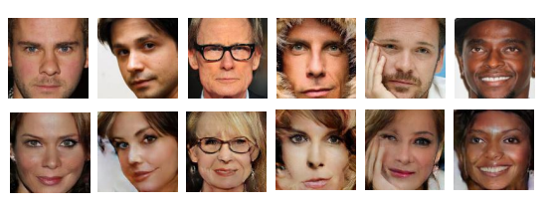
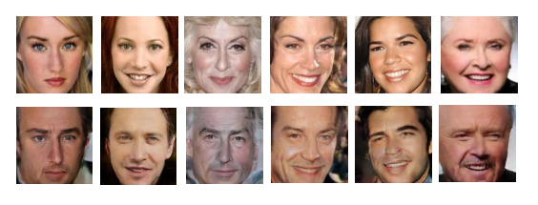
1. Introduction

Slide 5
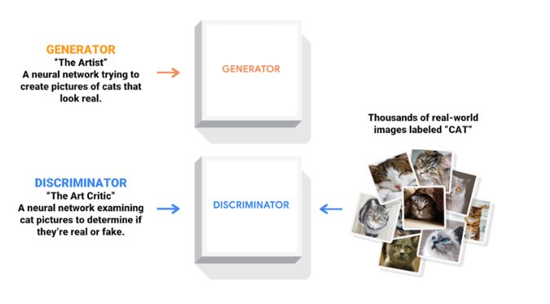
2. GANs Revision
Adversarial Networks (GANs) are a class of artificial intelligence algorithms introduced by Ian Goodfellow and his colleagues in 2014.
GANs are designed for generative tasks, aiming to create new data instances that resemble a given dataset.
GANs consist of two models: generator and discriminator

Slide 6
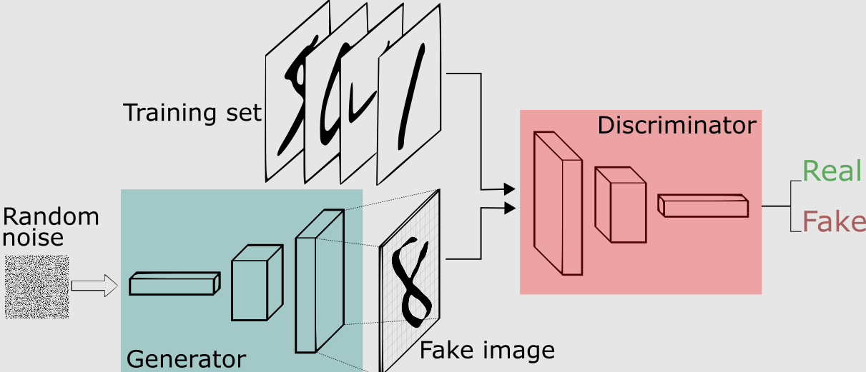
2. GANs Revision
Generator (G):
The generator is a neural network responsible for creating synthetic data.
It takes random noise as input and transforms it into data that should resemble the real data.
Discriminator (D):
The discriminator is another neural network that acts as a binary classifier.
It distinguishes between real data from the dataset and fake data generated by the generator
Minimax two-player game between Generator vs Discriminator

Slide 7
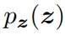
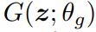
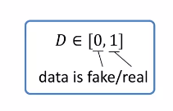
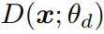
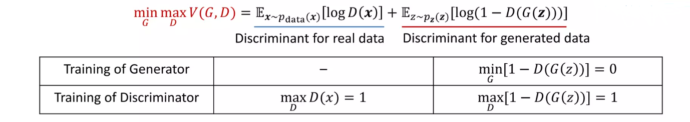
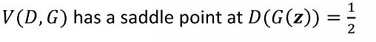
2. GANs Revision
Minimax problem of GANs
Input random noise:
Generator data:
Discriminator:

Slide 8
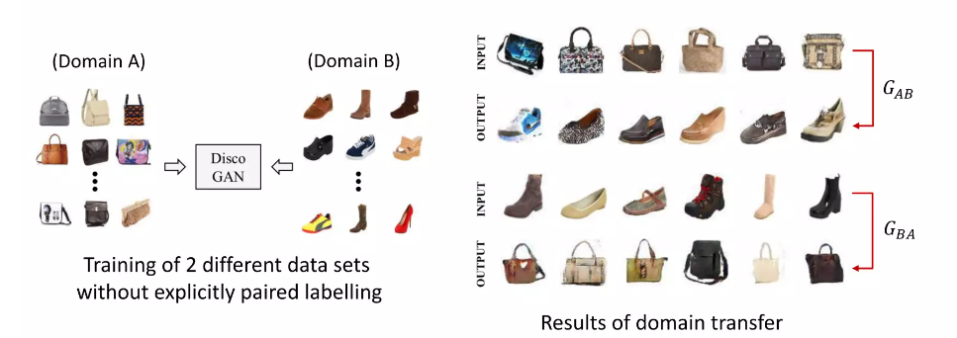
3. DiscoGAN
Discover Cross-Domain Relations with GANs.
Previous AI (~2017) could also transfer data from one domain to another, preserving key attributes such as: Pix2Pix, …
These training methods required paired data, that is costly and hard to collect
DiscoGAN required 2 different data sets without any paired data, and the results show better performance with robustness to model collapse

Slide 9
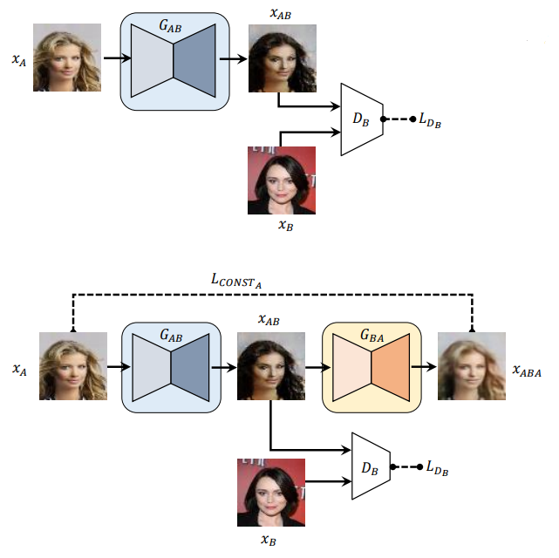
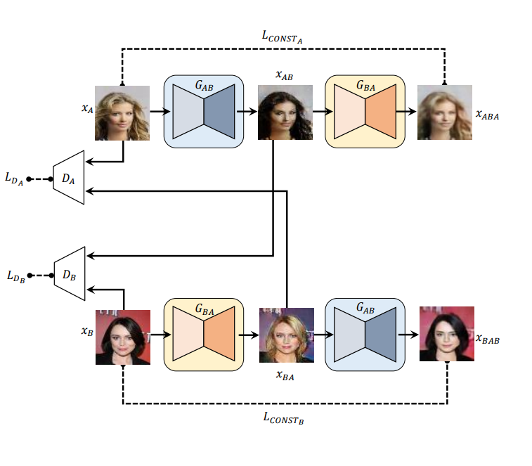
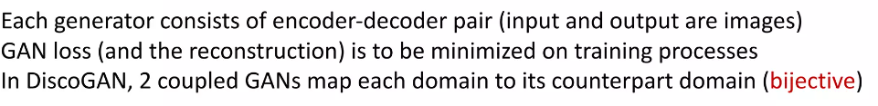
3. DiscoGAN: Network models

Slide 10
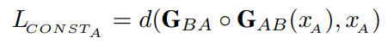
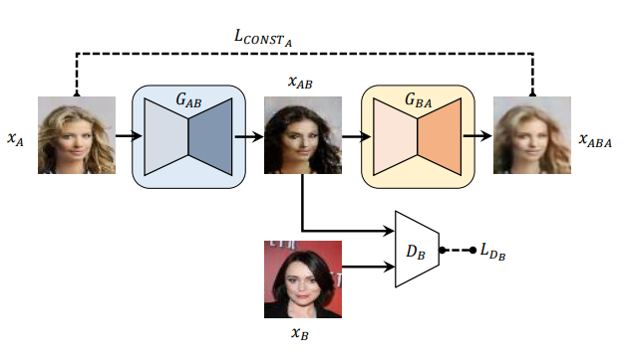
3. DiscoGAN: Idea
Intuition of cross domain: constraint all images in one domain to be representable by images in the other domain
Reconstruct loss: measures how well original input is reconstructed after a sequence of two generation:
Gans Loss: measures how good image is in domain B
This is only injection mapping
One side mapping

Slide 11
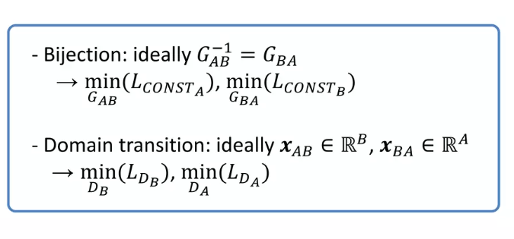
3. DiscoGAN: Idea
2 models coupled to guarantee bijection and domain transition

Slide 12
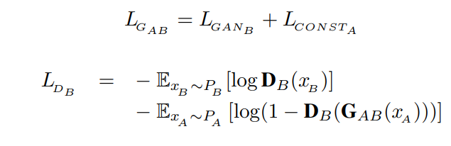
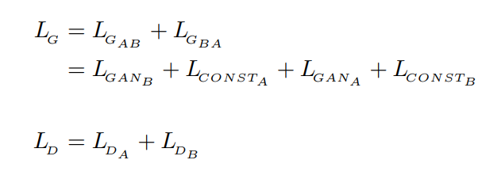
3. DiscoGAN: Idea
GAN with a reconstruction loss and Gan loss
DiscoGAN

Slide 13
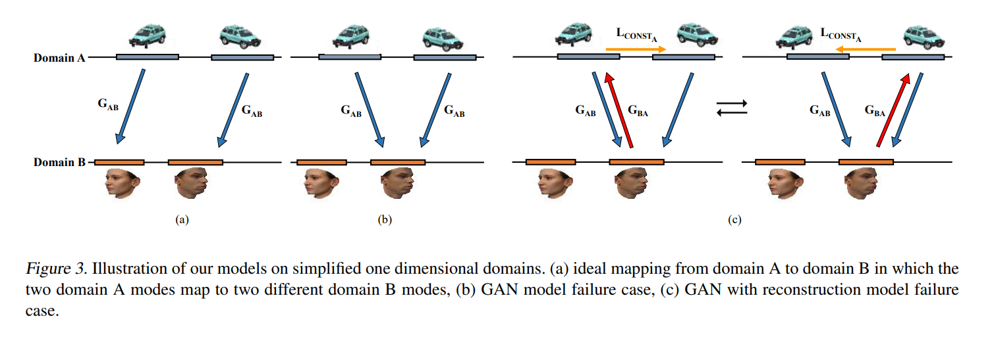
3. DiscoGAN: Mode Collapse

Slide 14
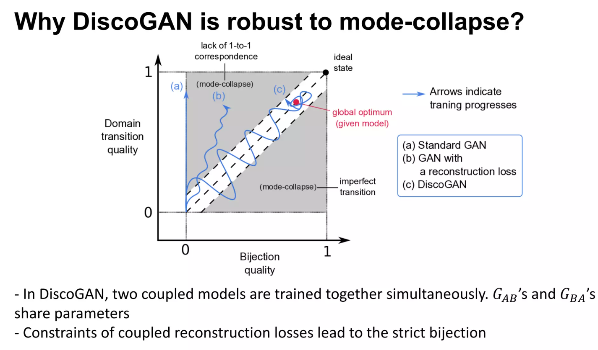
3. DiscoGAN

Slide 15
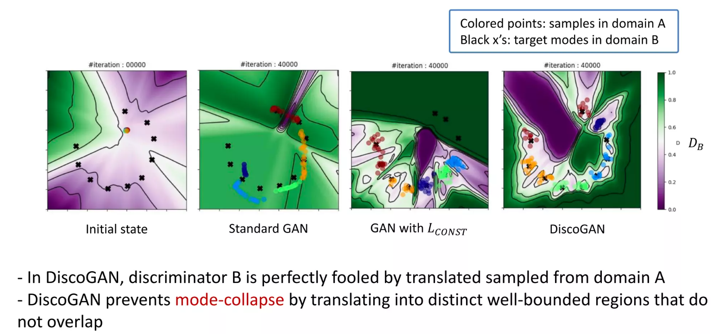
3. DiscoGAN: Performance

Slide 16

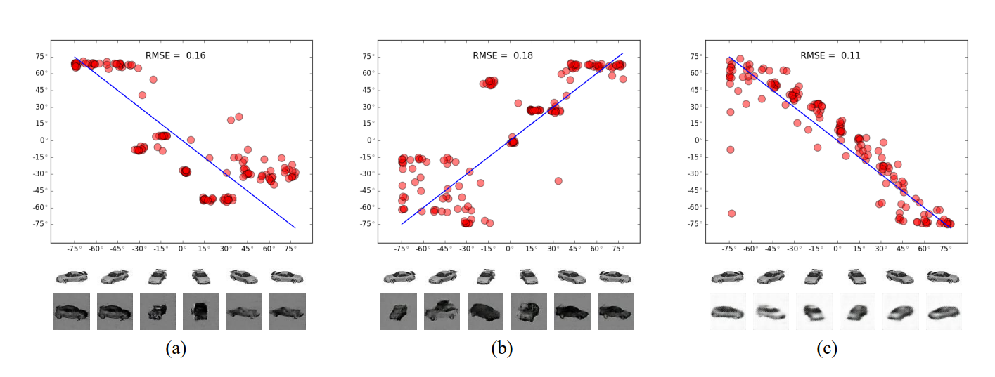
3. DiscoGAN: Performance

Slide 17
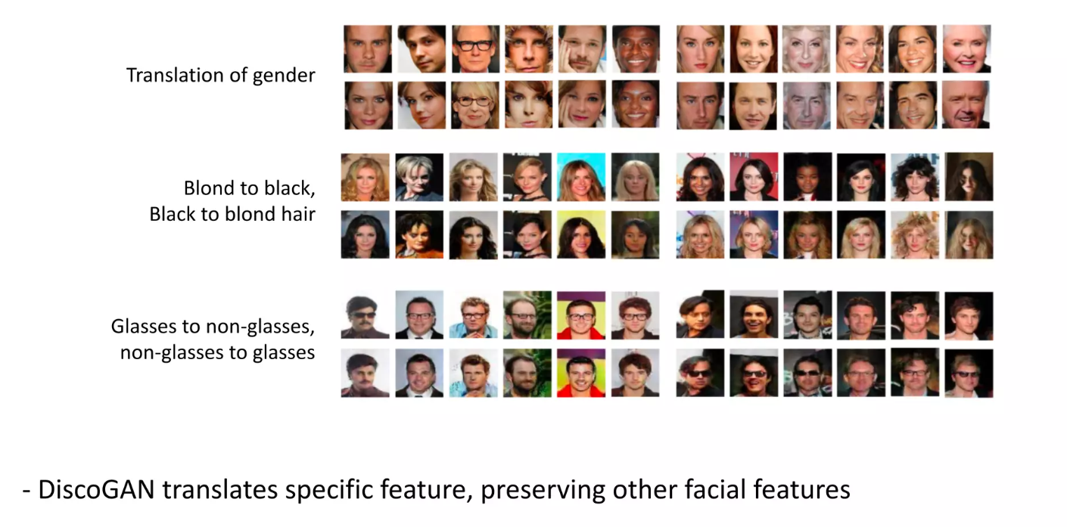
3. DiscoGAN: Performance

Slide 18
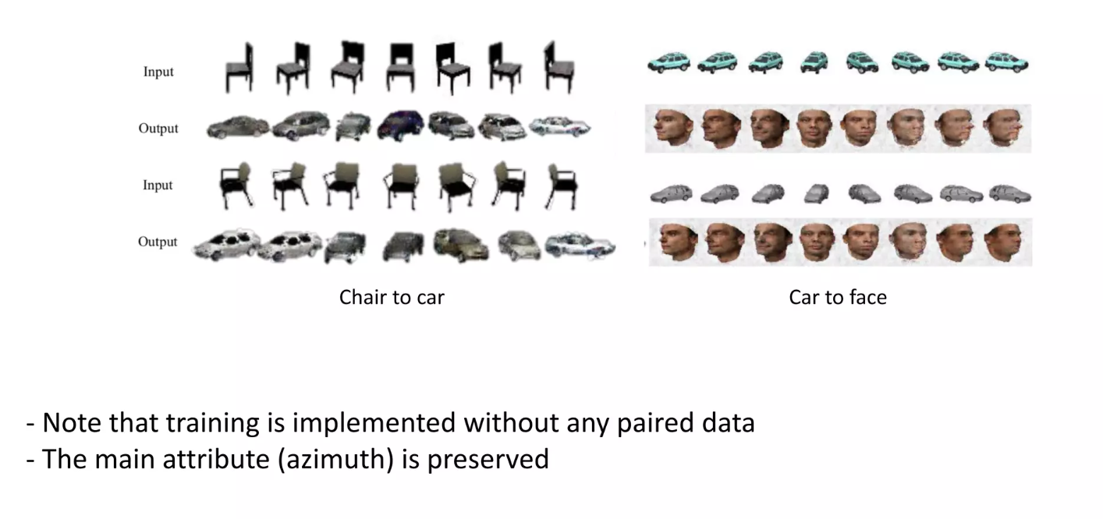
3. DiscoGAN: Performance

Slide 19
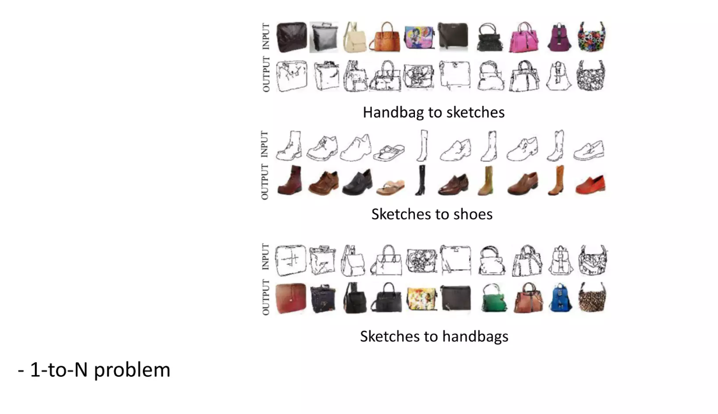
3. DiscoGAN: Performance

Slide 20
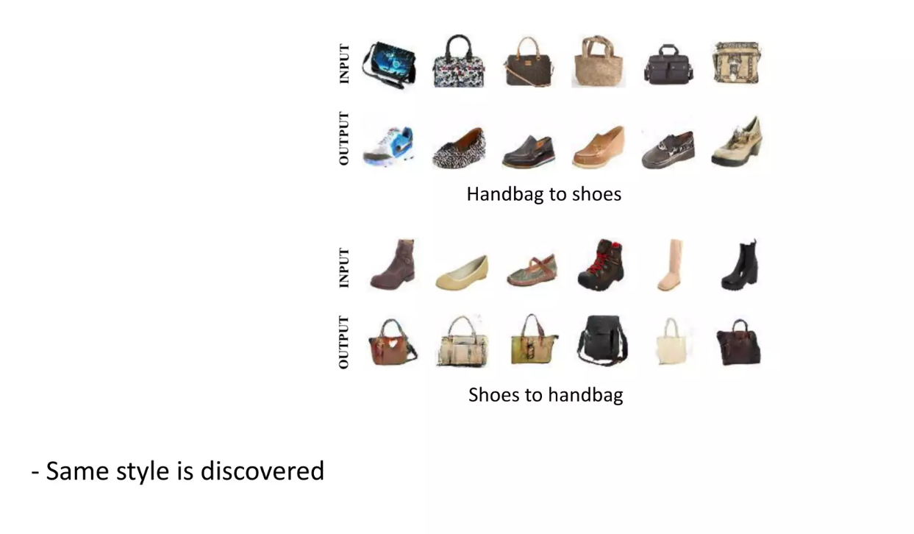
3. DiscoGAN: Performance

Slide 21
3. DiscoGAN: Summary
DiscoGAN is proposed as a learning method to discover over cross-domain relations without any pair labels
Results show better performance with robustness to mode collapse
Symmetry design by coupling 2 GANs
https://github.com/SKTBrain/DiscoGAN.git

Slide 22
QUESTION

